Slide 1
Biomedical Image Analysis
CIS 537/BE 537
Fall 2018
Notes:
----- Meeting Notes (1/9/13 14:58) -----
Name
Degree/Program
Your interest in image analysis
Relevant experience

Slide 2
Plan for Today
Discuss image analysis
Review syllabus

Slide 3
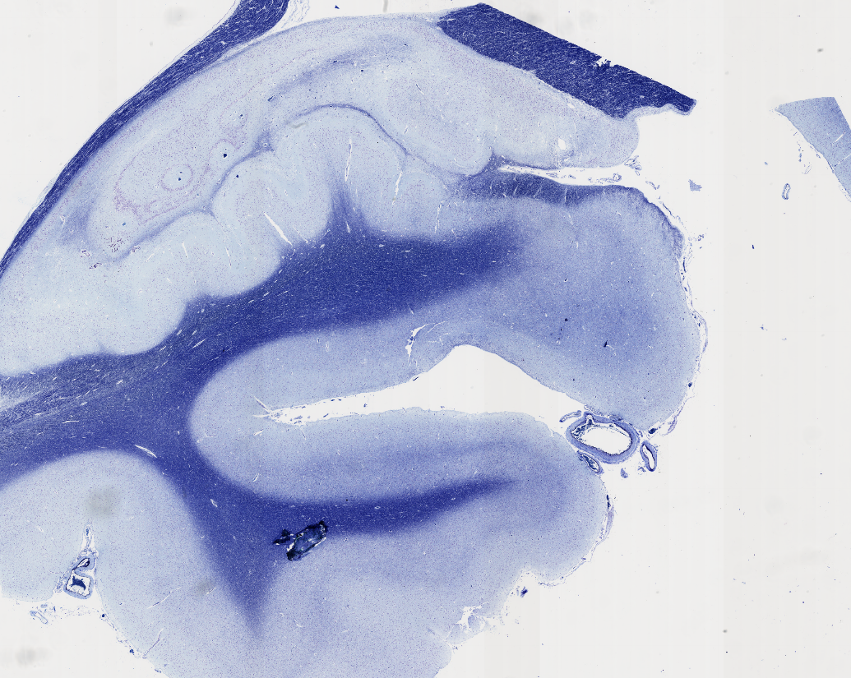
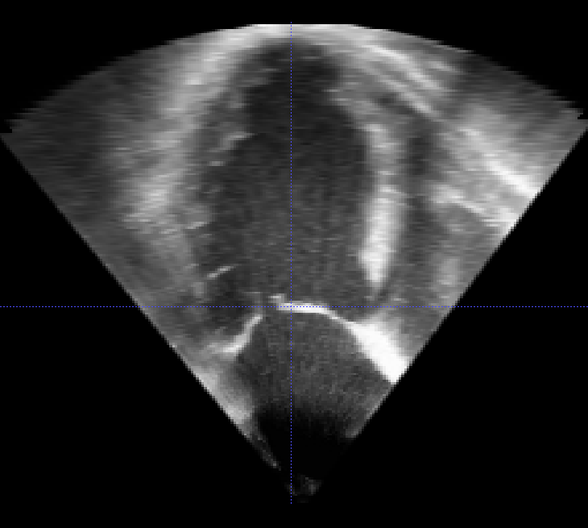
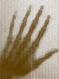
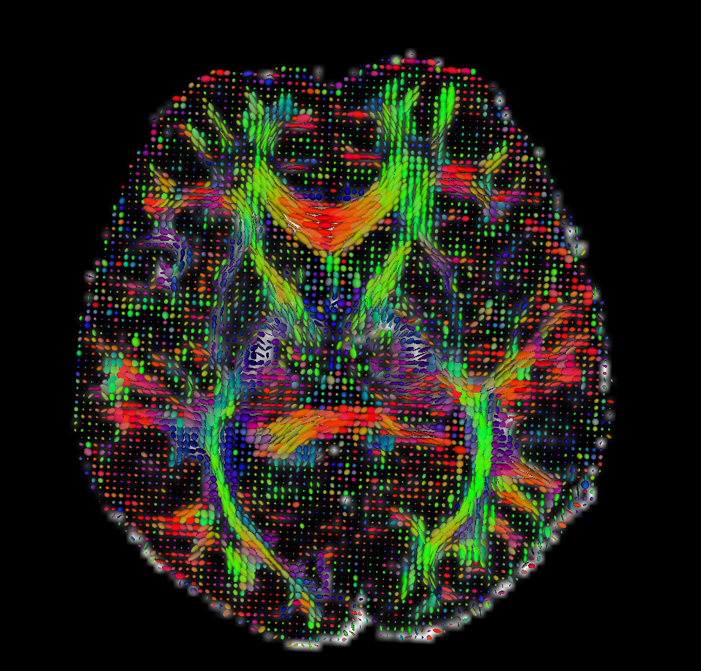
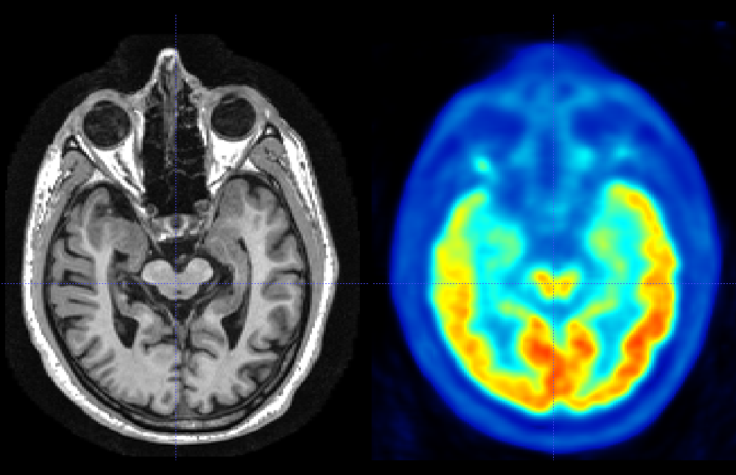
First, let’s take a look at some medical images!
*
* One of the first x-ray images taken at Penn. Source: http://www.uphs.upenn.edu/radiology/about/history/
Notes:
What to show?
CT and MRI on Fpbio? Good introduction to slicing
http://fpb.ceb.cam.ac.uk/demo/index.html
Compare to viewing brain images in ITK-SNAP
4D Lung CT
On the laptop
Highlight anisotropy
4D valve ultrasound
On the laptop
Show paraview too
3D placenta ultrasound
Deep learning
Histology
Open using online Leica viewer
Safari, go to slidehosting.eu, aaicguest, leica
Case 65 for Tau. Case 147 for H&E of cells
https://slidehosting.eu/imageserver/@@_oMuyUaVqHX0b4RAUhfznaaBe0rIisSg7i2KDYb_spjeS6XLKShXPg==/@65/view.apml
Clarity
https://www.youtube.com/watch?v=c-NMfp13Uug
MRI and PET pair
Discuss how PET is being used to do “histology in vivo”
DCE-MRI in Horos and Qt
Diffusion MRI?

Slide 4
What are different ways to classify biomedical images?
Dimensionality (2D, 3D, 4D)
…
…
…
Notes:
Make a list on the board…
Structural vs. functional
Univariate vs. multivariate
Invasive vs. non-invasive
Expensive vs. Cheap
Time-varying vs. Single timepoint
Single-component vs. multi-component

Slide 5
What are different ways to classify biomedical images?
Dimensionality (2D, 3D, 4D)
Scale (microscopic vs. macroscopic)
Univariate vs. Multivariate
Structural vs. Functional
Invasive vs. Non-invasive
Cost
Notes:
Make a list on the board…
Structural vs. functional
Univariate vs. multivariate
Invasive vs. non-invasive
Expensive vs. Cheap
Time-varying vs. Single timepoint

Slide 6
How can quantitative biomedical imaging help
Diagnose disease?
Guide surgical interventions?
Develop new treatments?
Understand the ”wiring” of the human brain?
Understand how the brain functions?
Understand genetic factors contributing to normal development and disease
Develop safer consumer products?

Slide 7
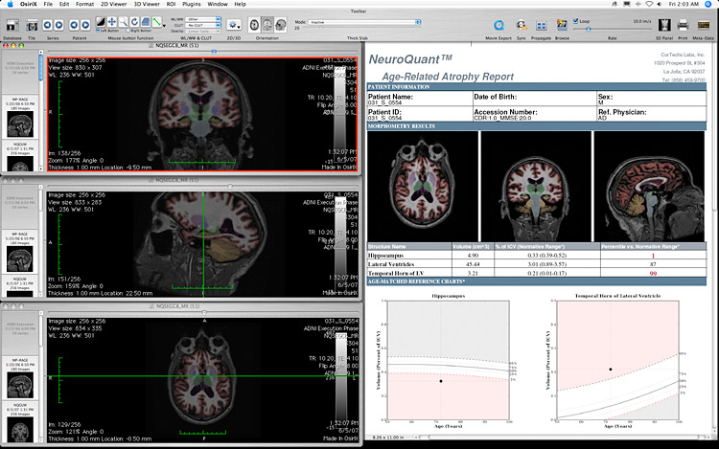
Automatic Evaluation of Medial Temporal Lobe Atrophy in Aging and Dementia
Source: Cortech Labs (cortechs.net), 2013.

Slide 8
Predicting breast cancer recurrence using contrast-enhanced MRI and gene expression
Ashraf et al., Radiology, 2014
Tumor size, shape
Kinetic features
Heterogeneity
Notes:
From Despina Kontos @ Penn Radiology
Determining which tumors are high-risk or low-risk can help determine optimal treatment
Imaging contributes to ability to predict recurrence
Example of how quantitative image analysis can help guide treatment

Slide 9
Diffusion MRI in surgical planning
Slide Credit: John A Detre, M.D., 2008

Slide 10
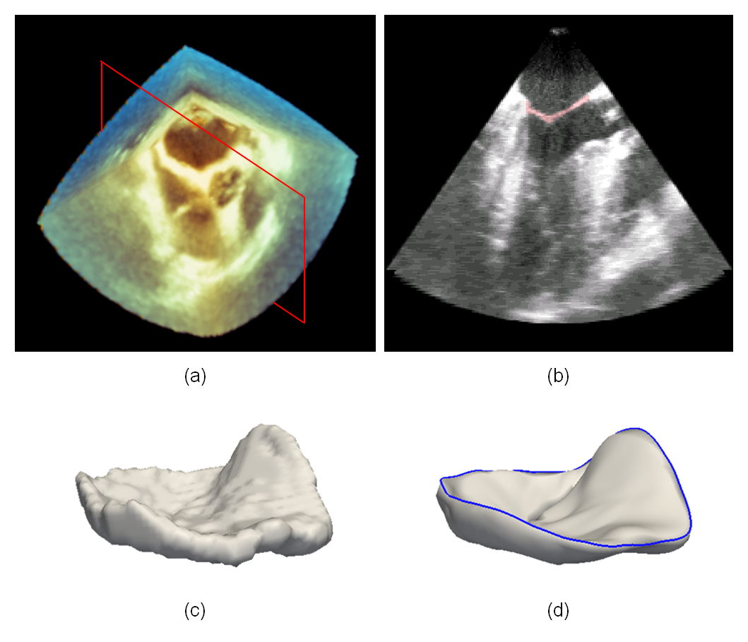
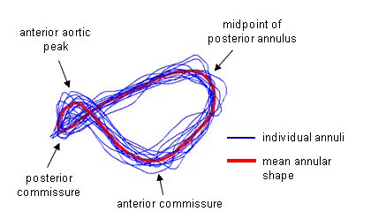
Variability in normal mitral annular geometry and its impact on annuloplasty ring selection and design Pouch et al., AHA Meeting, 2012
Figure 1. (a) 3D TEE image volume of the closed mitral valve. (b) 2D slice of the 3D TEE image with the automatic segmentation of the mitral leaflets shown in red. (c) 3D segmentation of the mitral leaflets. (d) Geometric model of the mitral leaflets with the annular curve shown in blue.

Slide 11
In vivo staging of tangle pathology in Alzheimer’s disease with PET scans
Schöll et al., Neuron, 2016
Notes:
Explain the pathology of AD
Amyloid - high risk of developing AD, but may take years/decades
Tau - more directly precedes neural loss
We are now able to image both in vivo

Slide 12
In vivo staging of tangle pathology in Alzheimer’s disease with PET scans
Schöll et al., Neuron, 2016
Notes:
Researchers working on using combined analysis of PET and MRI to determine which pathological stage of disease patients are in, something that was previously only possible postmortem

Slide 13
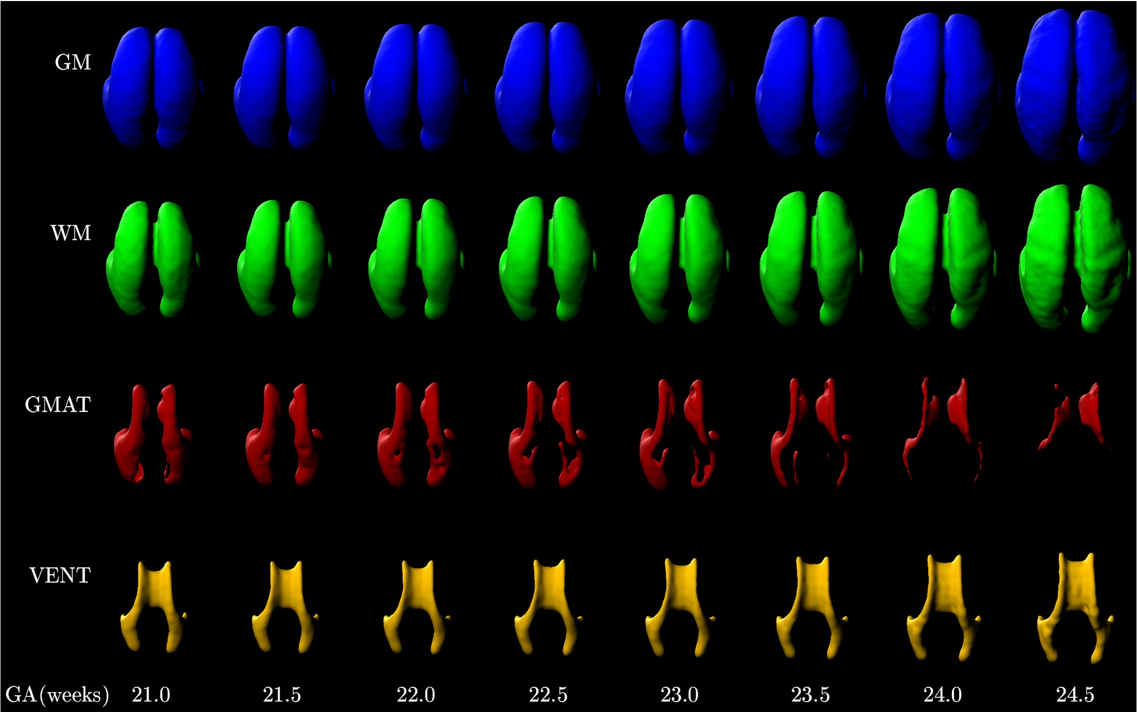
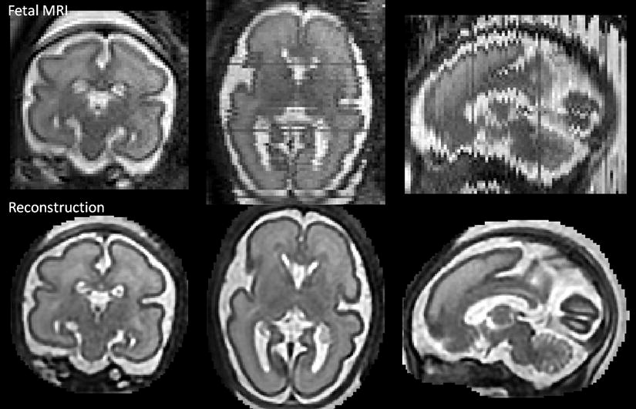
Mapping fetal brain development Habas el al., Neuroimage, 2010, Kuklisova-Murgasova et al., 2012

Slide 14
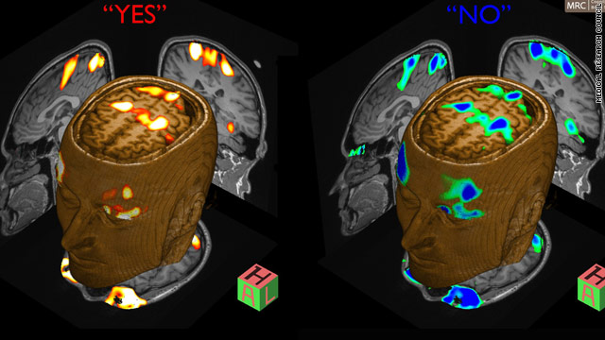
Communicating with patients in vegetative state using fMRI Owen el al., Science, 2010
* Source: P. Wilkinson, ‘Vegetative state’ man responds to questions, CNN, Feb. 9, 2010.

Slide 15
Deriving anatomical brain regions based on anatomy, function, and connectivity
Glasser et al., Nature, 2016

Slide 16
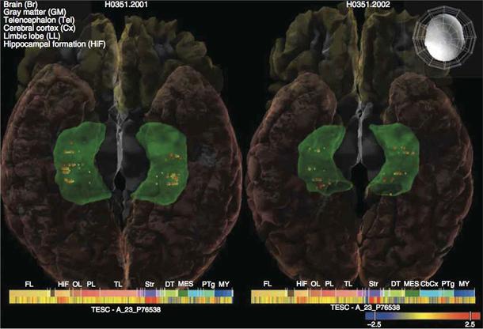
Collaborative analysis of gene expression in the human brain Stein et al., Nature Genetics, 2012

Slide 17
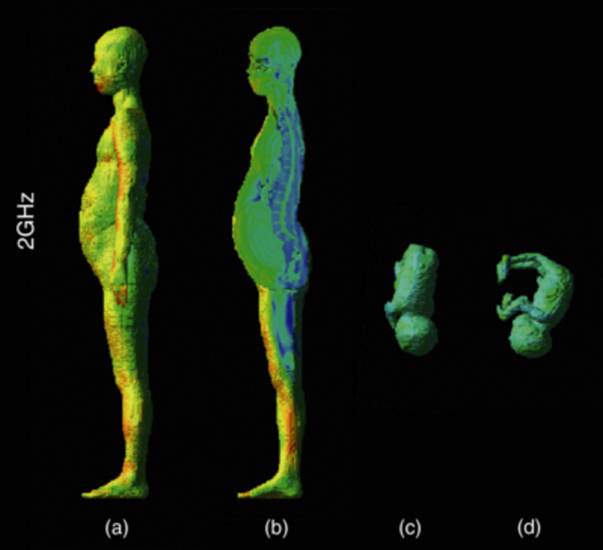
Computational phantoms derived from cadaver imaging used to improve product safety
Xu, Med Phys Biol, 2014
SAR
Nagaoka et al., Med Phys Biol, 2007

Slide 18
What types of quantitative measures do we need to extract from medical images?
Volumes (e.g., hippocampus volume)
…
…
…
…

Slide 19
What types of quantitative measures do we need to extract from medical images?
Volumes (e.g., hippocampus volume)
Thickness (e.g. heart wall thickness)
Locations of pathology (e.g. locations of lesion centers)
Average XXX over a structure (e.g., metabolism)
Changes in all of the above over time
Differences in connectivity between structures

Slide 20
What image processing tools do we need to extract these quantitative measures?

Slide 21
TOOLS OF IMAGE ANALYSIS
Segmentation
Identify objects of interest in medical images
Normalization
Find correspondences between individual anatomies
Align multi-modality images of same anatomy
Morphometry
Quantify differences between anatomies

Slide 22
Instructor: Paul Yushkevich
Training: Computer Science @ UNC
At Penn (Radiology) since 2003
Research:
Imaging biomarkers for Alzheimer’s disease
Detailed imaging & anatomical modeling of the hippocampus
Automatic segmentation algorithms
Geometrical modeling of anatomy using medial axes
Open-source software
ITK-SNAP, Convert3D, Greedy

Slide 23
Teaching Assistant: Ahmed Aly
M.D., PhD student in Biomedical Engineering
Research:
Heart valve disease
Multi-atlas segmentation
Deep learning

Slide 24
PREREQUISITES
Mathematics
Multivariate calculus is a must
Statistics and linear algebra are very important
Differential equations a plus
Programming
Programming experience is needed
Assignments are in MATLAB

Slide 25
Assignments and Grades
Daily reading
In GitHub
MATLAB assignments (3 x 14%)
Quizzes(3 x 6%)
Group project (40%)

Slide 26
MATLAB assignments
Three assignments through the semester
Image processing, how to work with 3D images in MATLAB
Registration
Segmentation
You can work in groups of two or on your own
Groups must be changed between assignments
Each group member should do all the work!
Don’t split assignments up into parts
All questions should go through Piazza

Slide 27
Quizzes
After MATLAB assignments
30 min at start of class
M/C questions to cover general concepts for last module
Longer response question related to the assignment

Slide 28
Team Project
Student teams will work with Penn clinical and image analysis researchers to solve real-world image analysis problems
Expectation: 60-90 hours per student, 3-4 students per project
Stages of the project:
Attend Project “Fair” on 9/5
Pick Project
Proposal & Revised Proposal
Mid-Project Report
Final Oral Presentation
Final Project Document

Slide 29
Project Fair – 9/5 (next class)
Sponsors will present their projects in class
I will post a sign-up sheet for projects
first-come, first-serve
After teams are formed, contact the sponsors and set up initial meeting

Slide 30
RESOURCES
Canvas
Syllabus
Modules
Reading assignments
Lecture notes
Assignments
Piazza
Use for all TA/instructor questions, group discussions, assignments

Slide 31
HOMEWORK POLICY
Timeliness:
Deadlines for all assignments are on Canvas and in the syllabus
Assignments are late if not turned in by beginning of class
Late penalty assessed (see syllabus)
How to turn in:
Submit entire assignment via Canvas
DO NOT email assignments – they will not be accepted

Slide 32
Academic Integrity
Syllabus spells out academic integrity policy
All work must be your original work.
If portions are derived from someone else’s work, this must be properly documented and cited. You must make it absolutely clear what part of the work is your original work, and what is derived.
Know what constitutes plagiarism and how to avoid it
Know how to properly quote text taken from sources

Slide 33
Academic Integrity: Source Code
All source code must be your original source code.
You may use all functions in MATLAB unless the assignment says not to.
If you need to use an external library, clear this with the instructor on Piazza ahead of the deadline.
It is okay to discuss assignments with other students, but not okay to give or borrow code from others

Slide 34
ACTION ITEMS FOR NEXT WEEK
Read the syllabus
Do the assignment for the “Project Teaser Day”
Canvas->Modules->Project Teaser Day
Complete the plagiarism assignment (due Sep 12)
Catch up or refresh if you need to:
MATLAB tutorials?
Multi-variate calculus and linear algebra
Partial derivatives, gradients, Green’s theorem, …

